Slide 1

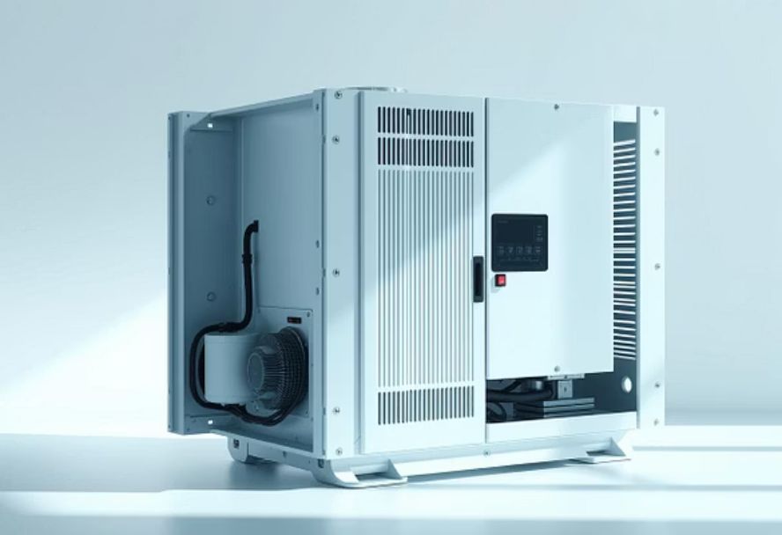
Advanced Thermal Management: Cooling of Power Electronics
A Presentation on Effective Cooling Strategies for Inverters and Converters.
Presenters
Institution & Instructor
Muhammad Ibrahim & Mohammad Ahtesam
Fast NUCES Islamabad, Campus
Instructor: Al-Bara Shalaby

Slide 2

Why Thermal Management Matters
Power electronic devices—such as inverters and converters—are critical components in modern electrical systems. However, their operation is inevitably linked to significant heat generation.
Heat Generation Sources
The Impact of Temperature
Heat is primarily generated within the semiconductor devices due to switching and conduction losses. These losses scale with power density and switching frequency.
Inefficient cooling directly reduces performance and shortens the component's lifespan, leading to premature failure and system unreliability.
Our objective is to explore robust cooling methodologies grounded in fundamental thermodynamic principles to achieve efficient thermal dissipation.

Slide 3
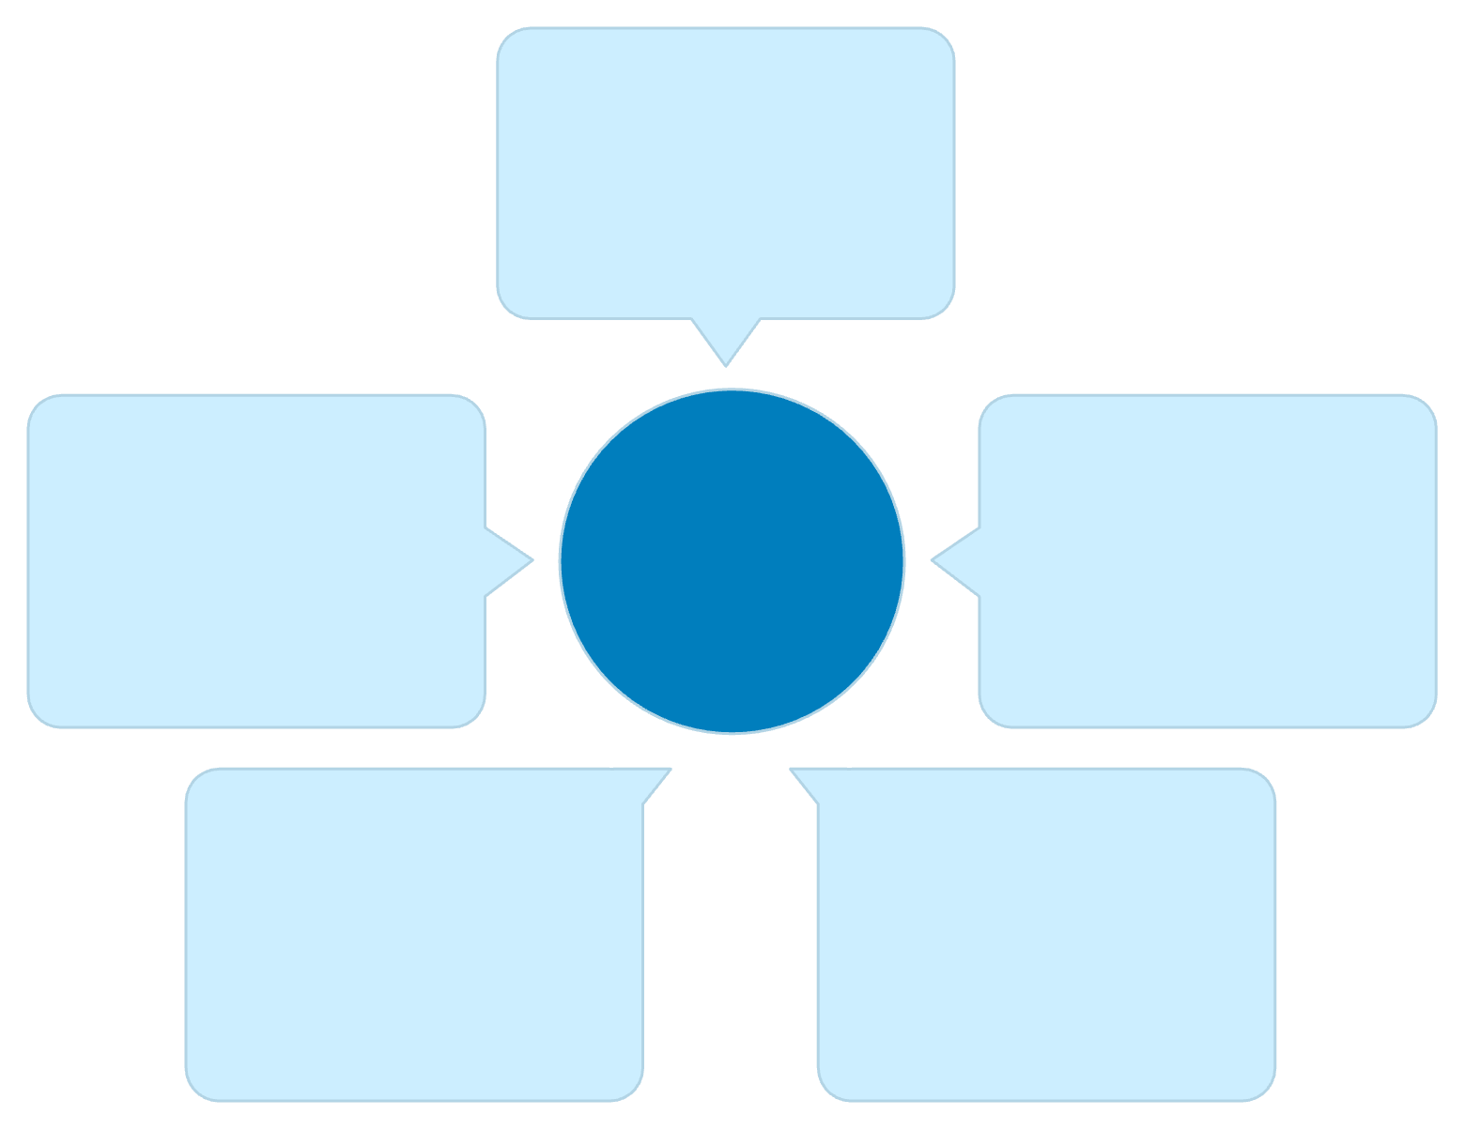
Understanding Heat Generation in Power Devices
The internal thermal load must be accurately calculated and managed to ensure safe operating temperatures. Excessive heat is the enemy of reliability.
Primary Heat Sources
IGBT Module A
Primary switching heat source
Semiconductor devices (IGBTs, MOSFETs, Diodes).
Switching losses (energy dissipated during turn-on/off).
Heat Sink
Inverter Thermal Dissipation
IGBT Module B
Conduction losses (resistance during 'on' state).
Collects and dissipates heat
Conduction and switching losses
Critical Effects
Heat Flow Arrows
IGBT Module C
Increased junction temperature accelerates material degradation, leading to failure modes like wire-bond lift-off and solder fatigue.
Directed toward heat sink
High-power thermal generation

Slide 4
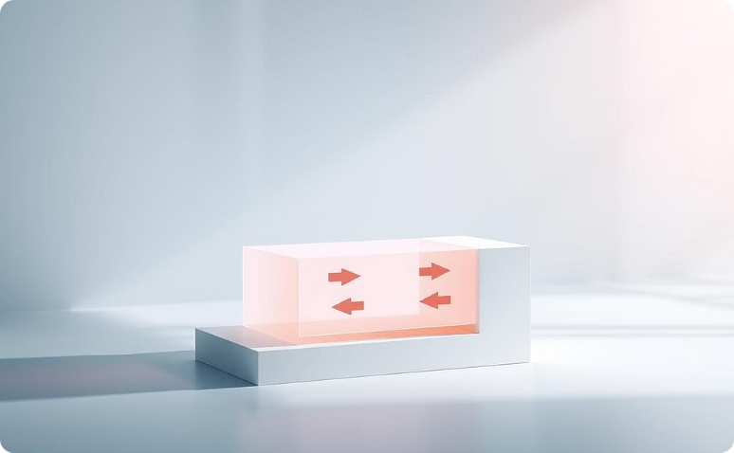
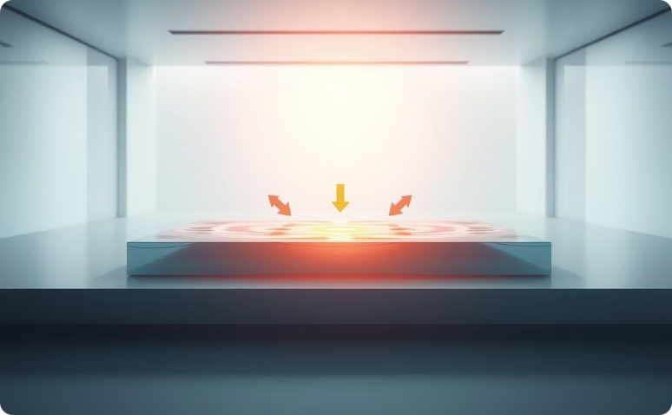
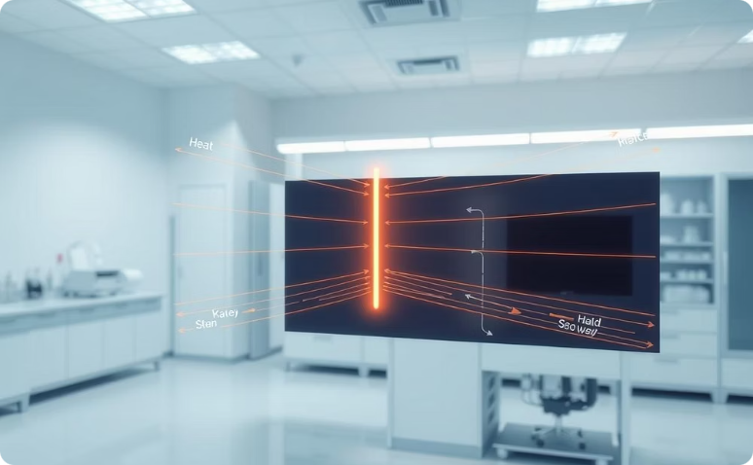
The Governing Laws of Heat Transfer
Thermal management relies on three fundamental modes of heat transfer to move energy from the semiconductor junction to the ambient environment.
Conduction
Convection
Radiation
Transfer through solid materials (junction, case, heat sink) governed by Fourier’s Law.
Transfer between a surface and a moving fluid (air or liquid) described by Newton’s Law of Cooling.
Energy emitted from hot surfaces as electromagnetic waves, significant at higher temperatures.
Newton's Law of Cooling (Convection)
Where Q is the heat transfer rate, h is the convection heat transfer coefficient, A is the surface area, and T is temperature.

Slide 5
Spectrum of Cooling Techniques
Cooling solutions are broadly categorised based on their requirement for external power input and system complexity.
Passive Cooling
Active Cooling
Heat sinks (finned aluminium or copper).
Forced convection via fans.
Natural convection and radiation.
Liquid cooling systems (water-glycol).
Thermal pads or interface materials (TIMs).
Advanced phase change materials (PCMs).
Characterised by low complexity and zero operating power.
Offers superior thermal performance but requires external energy.
Design Considerations
Metric
Cost
Thermal Efficiency
Complexity
Passive
Low
Moderate
Low
Active (Air)
Moderate
High
Moderate
Active (Liquid)
High
Very High
High

Slide 6
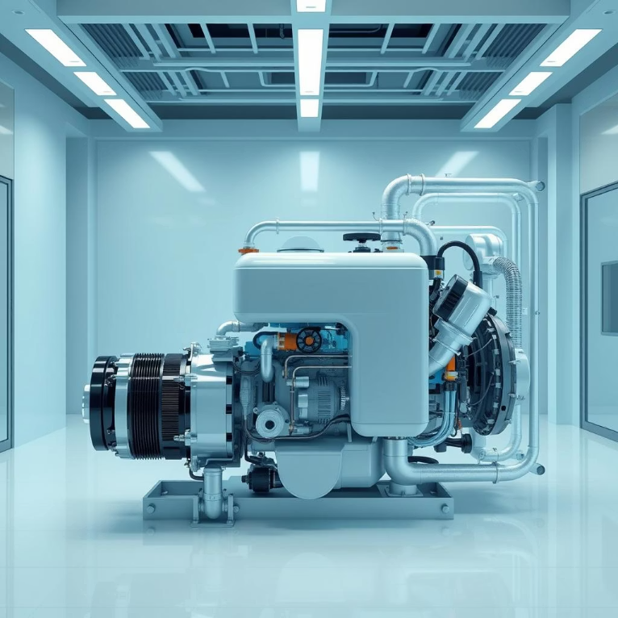
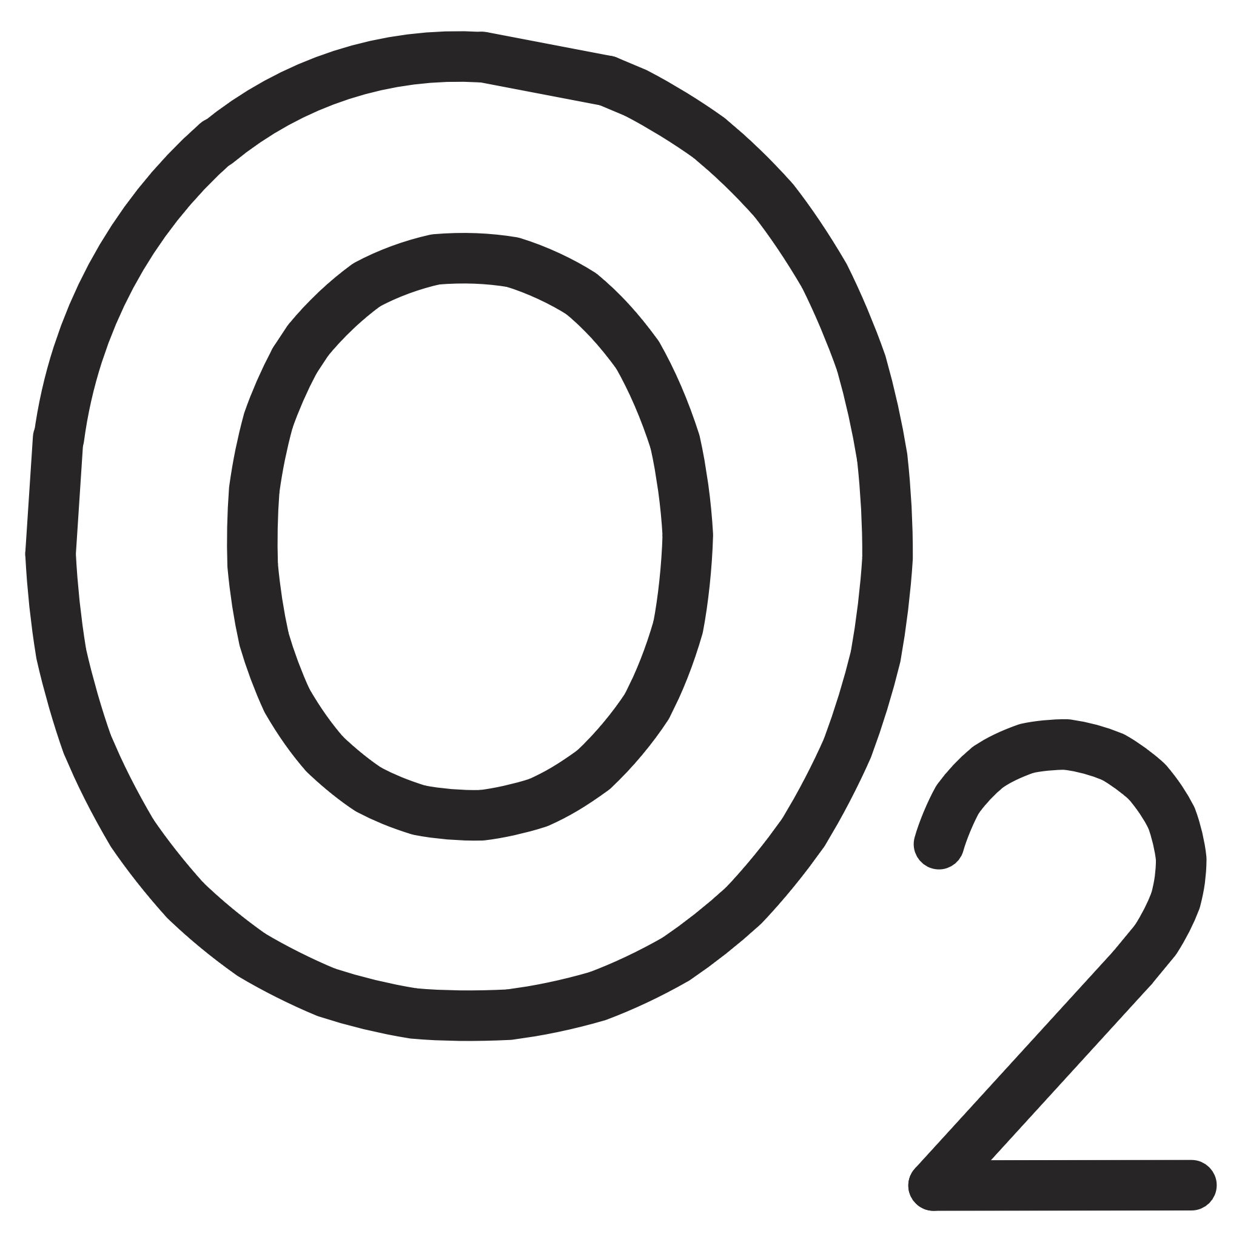

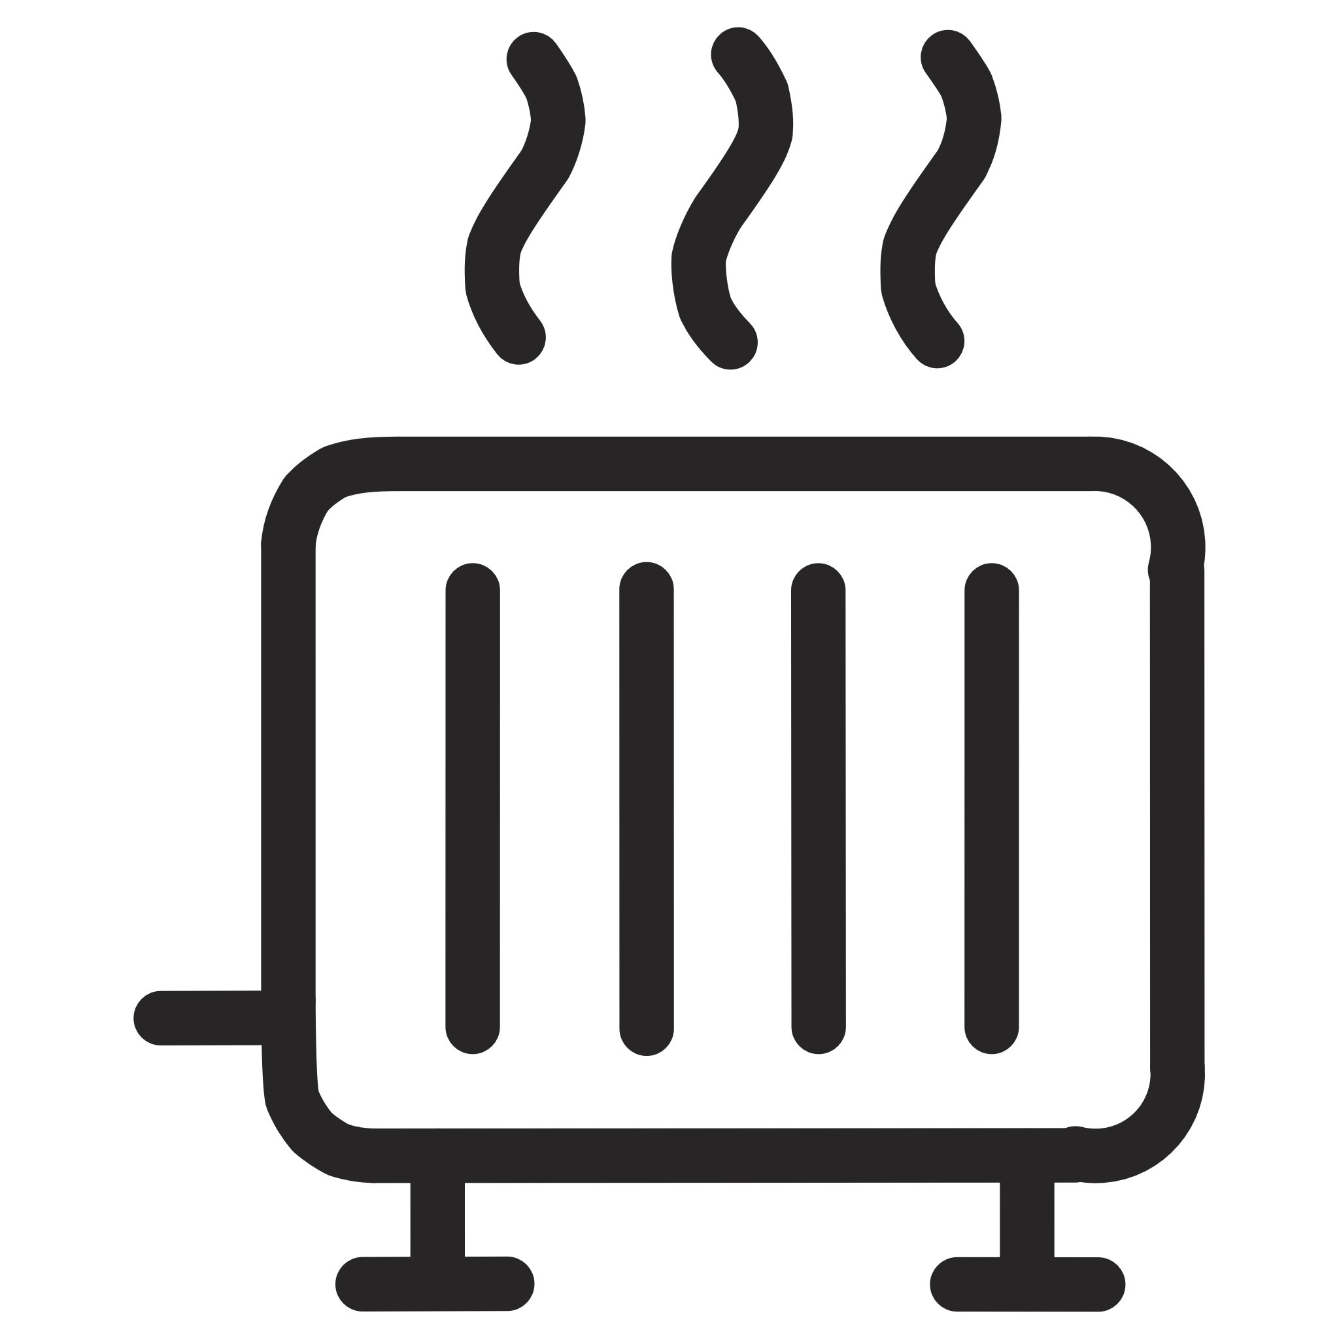
Real-World Application and Future Trends
Case Study: Electric Vehicle Inverter Cooling
EV inverters handle high power densities, making efficient cooling essential for vehicle range and charging speeds. These systems almost exclusively use direct liquid cooling with coolant channels integrated directly into the heat sink base plate.
Coolant: Water-glycol mixture.
High heat flux removal capacity.
Crucial for maintaining optimal battery and powertrain performance.
Modern Trends in Thermal Management
Nanofluids
Immersion Cooling
Two-Phase Cooling
Fluids engineered with nanoparticles (e.g., copper, silver) to significantly enhance thermal conductivity.
Submerging components directly in dielectric liquids for maximal, uniform heat removal.
Utilising the latent heat of vaporisation (e.g., in heat pipes) for highly efficient heat transfer at a constant temperature.

